Slide 1
Annual Operating Plan
Citi Finance
April 6, 2023
Notes:
1

Slide 2
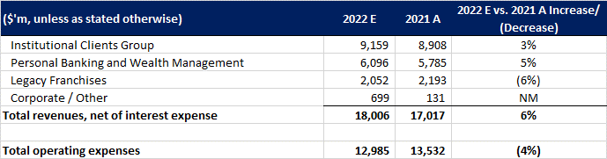
Financial Forecast to 31 Dec ’22

Slide 3
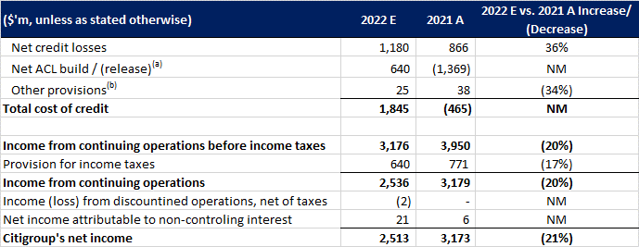
Financial Forecast to 31 Dec ’22 (cont.)
(a) Includes credit reserve build / (release) for loans and provision for credit losses on unfunded lending commitments. (b) Includes provisions for policyholder benefits and claims, HTM debt securities and other assets.

